Slide 1
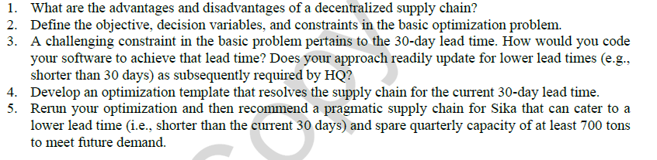
SIKA Case: Group assignment in Session for Class Participation assessment

